Slide 1

Dashboard KPIs Centros de Distribución LAO
Entrenamiento y Despliegue
16 Marzo 2021

Slide 2
Agenda
Introduction (5 min) Information Sources and Updates (5 min) Top Views (40 min) Kahoot! (10 minutes)
Introduction (5 min)
Information Sources and Updates (5 min)
Top Views (40 min)
Kahoot! (10 minutes)

Slide 3
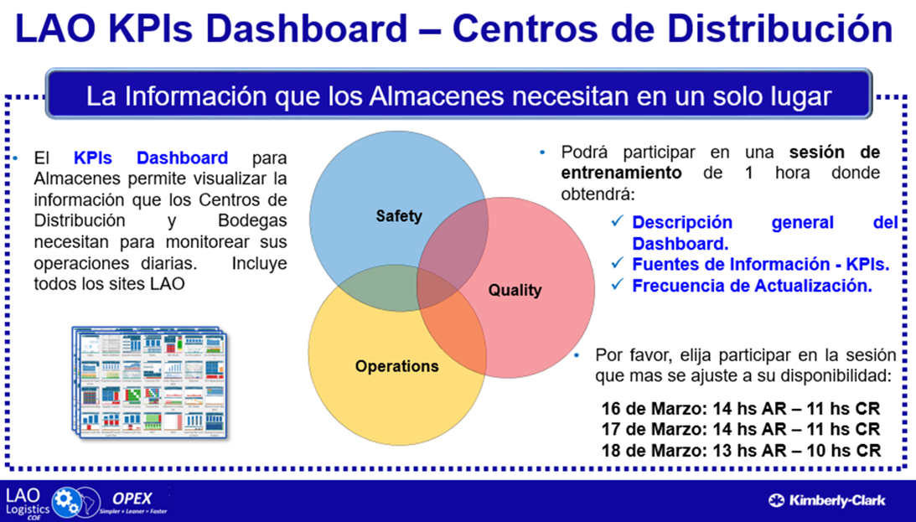

Slide 4
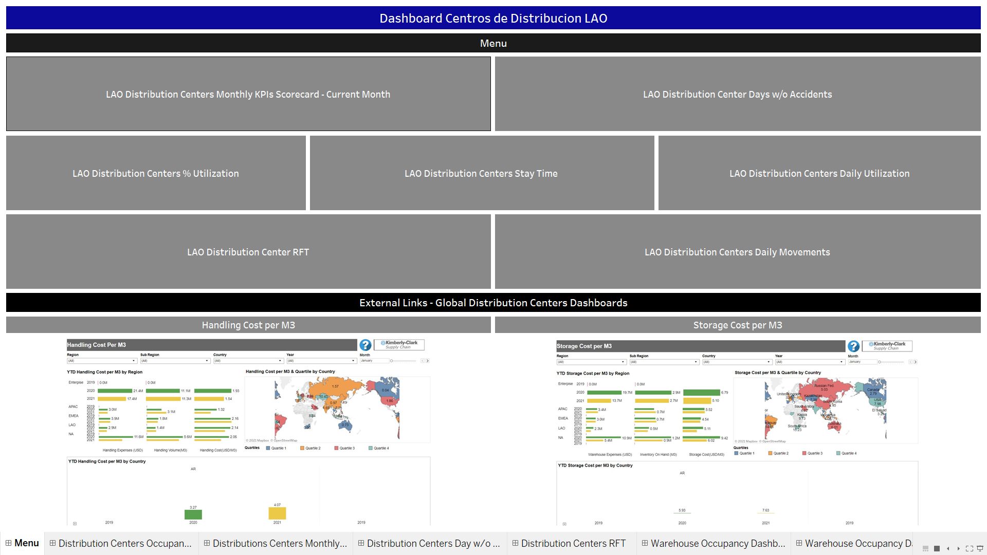
Main Views
Resumen
LAO Distribution Centers Monthly KPIs Scorecard - Current Month
LAO Distribution Centers % Utilization
Seguridad
LAO Distribution Centers Days w/o Accidentes
Calidad
LAO Distribution Centers RFT
Operaciones
LAO Distribution Centers Daily Utilization
LAO Distribution Centers Daily Movements
LAO Distribution Centers Stay Time
External Links: Global Distribution Centers Dashboards:
Handling Cost per M3
Storage Cost per M3

Slide 5

Information Sources and Updates
Inventories
(Available, Quality Control, Blocked)
SAP/R3
MB52
SAP/R3
ZFSLO214
SMOB Monthly Analysis
Update:
Monday to Friday 11:00 am
(Central Standard Time)
Movements
(Inbound, Outbound, Returns)
SAP/R3
MB51
Stay Times
(Transport Units)
SAP/R3
VT11
DC KPIs Database
Days without accidents
(EHS)
DC SharePoint
Days w/o Accident
RFT
(Quality)
RFT Move Reporting
DC SharePoint
Capacities

Slide 6
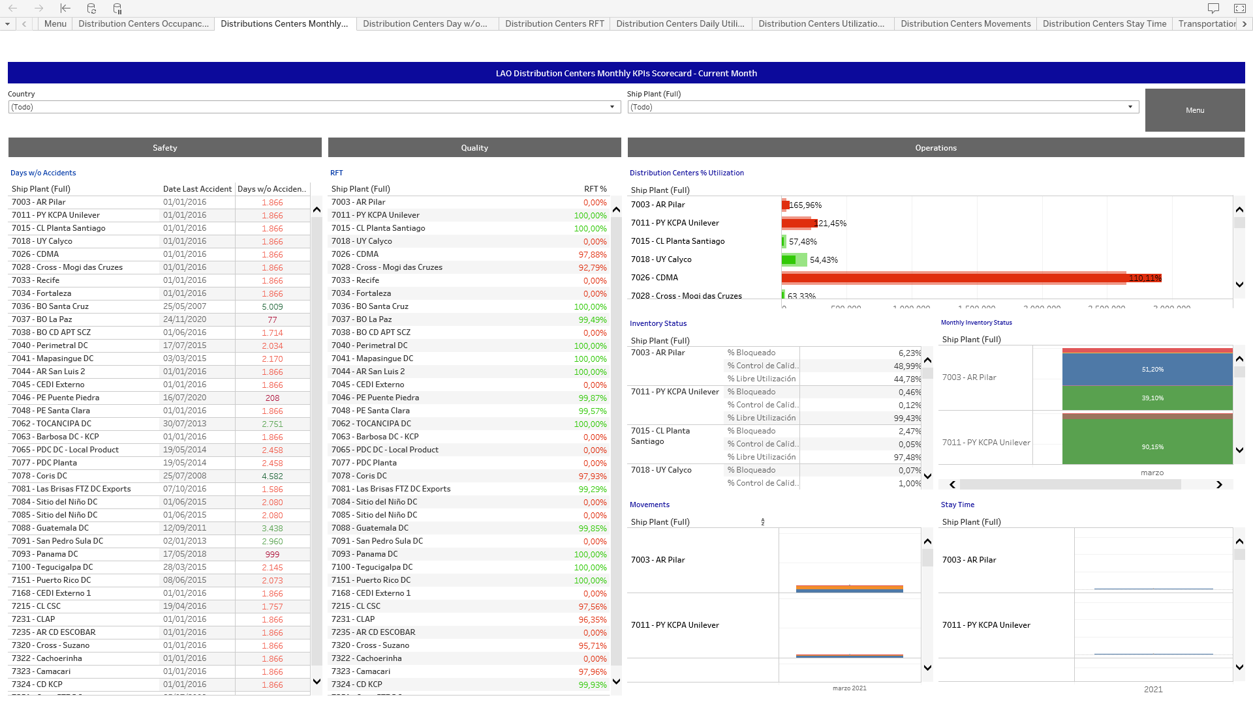
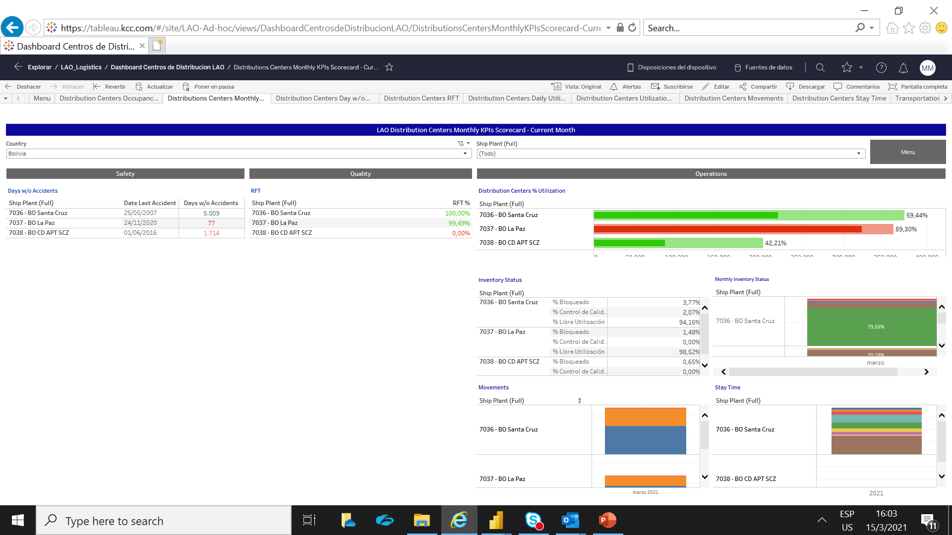
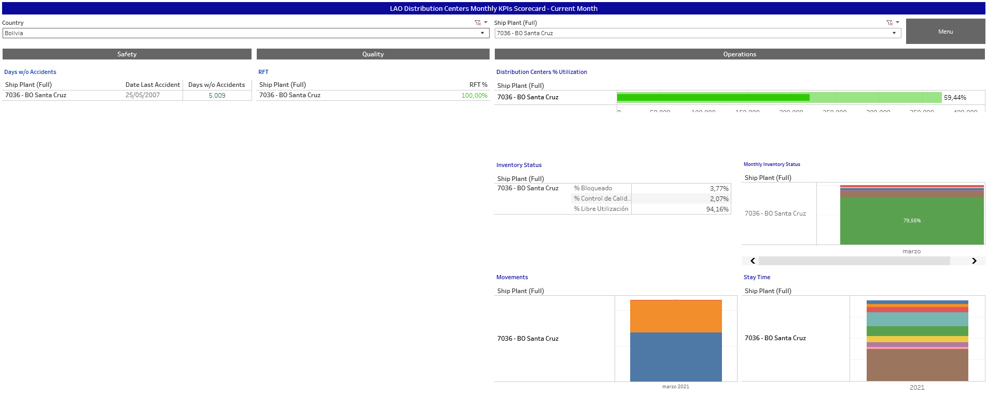
LAO Distribution Centers Monthly KPIs Scorecard - Current Month

Slide 7
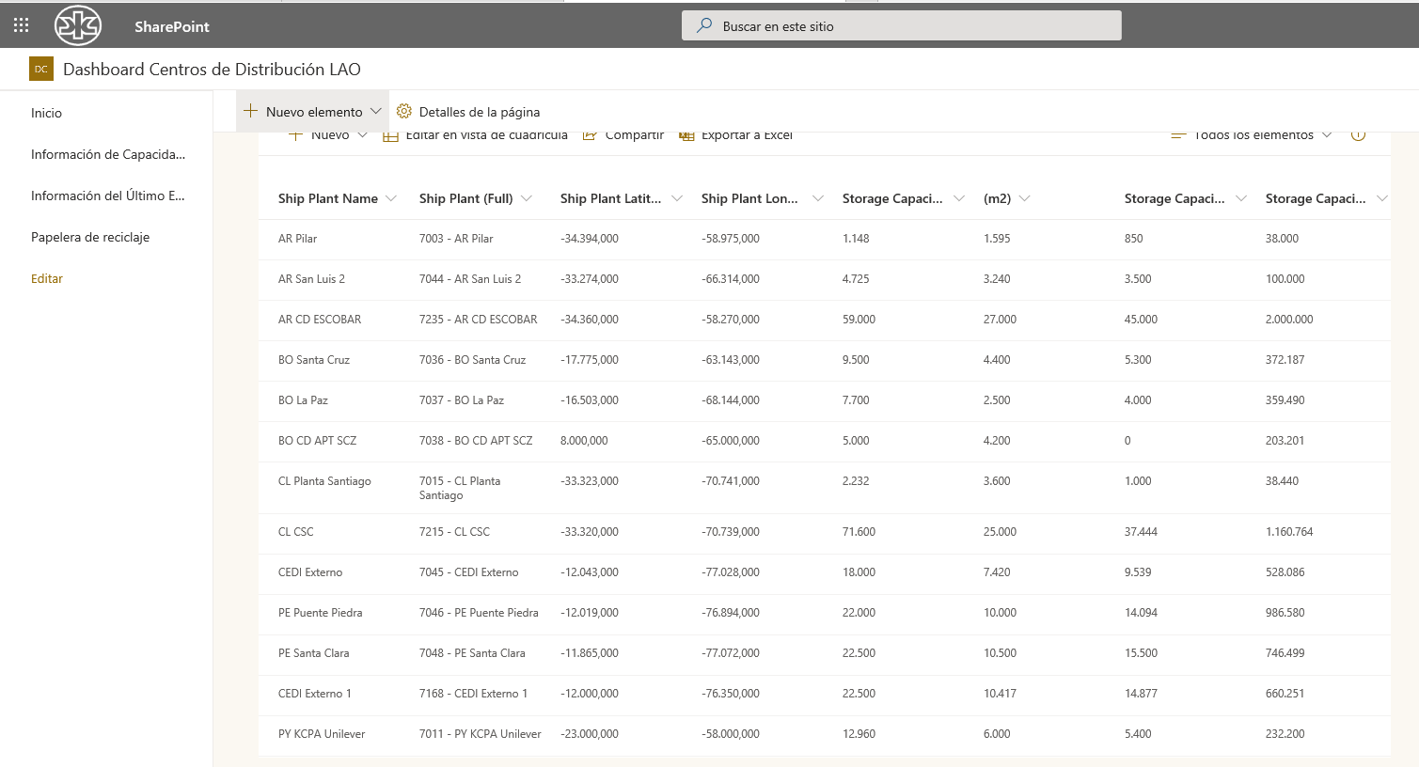
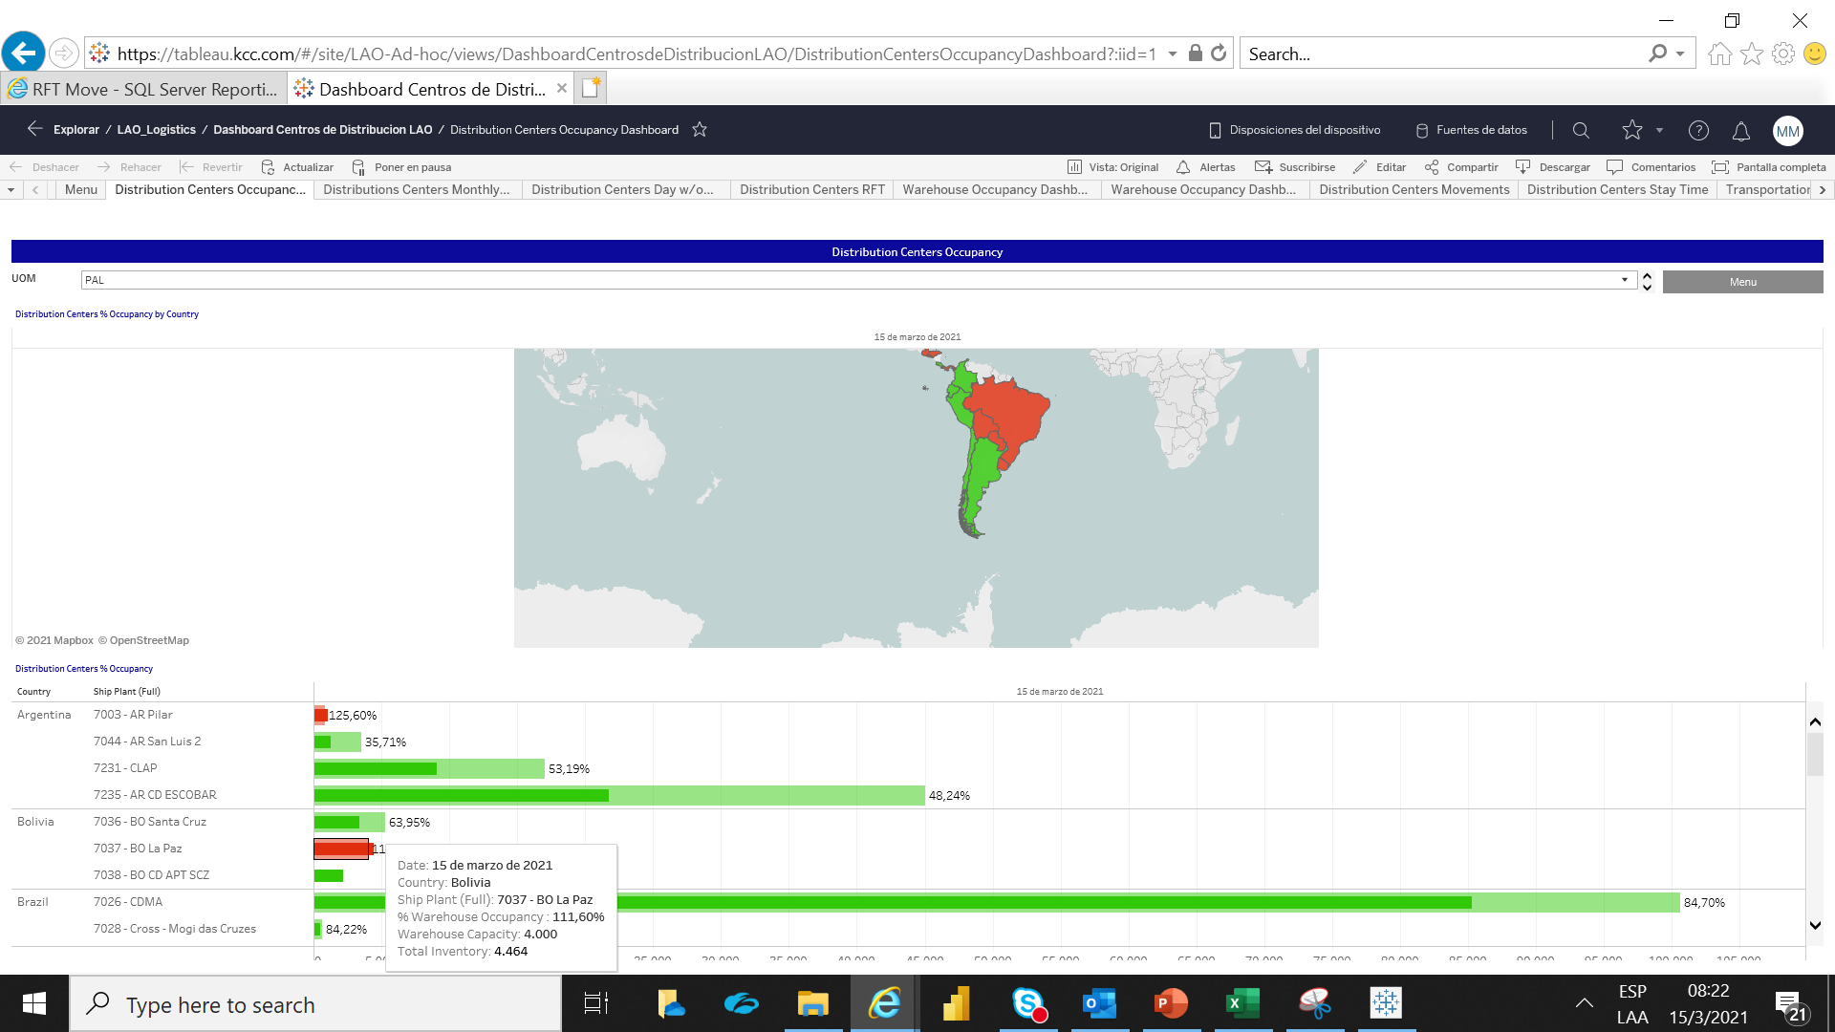
LAO Distribution Centers % Utilization
SAP/R3
MB52
Se puede encontrar en:
PAL
M3
CS
https://kimberlyclark.sharepoint.com/Sites/H854/DCKPISDashboard/

Slide 8
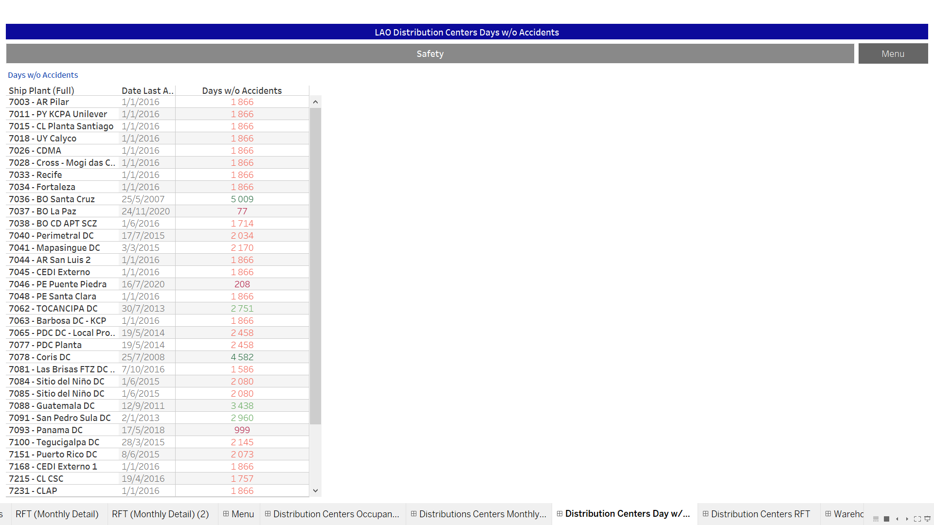
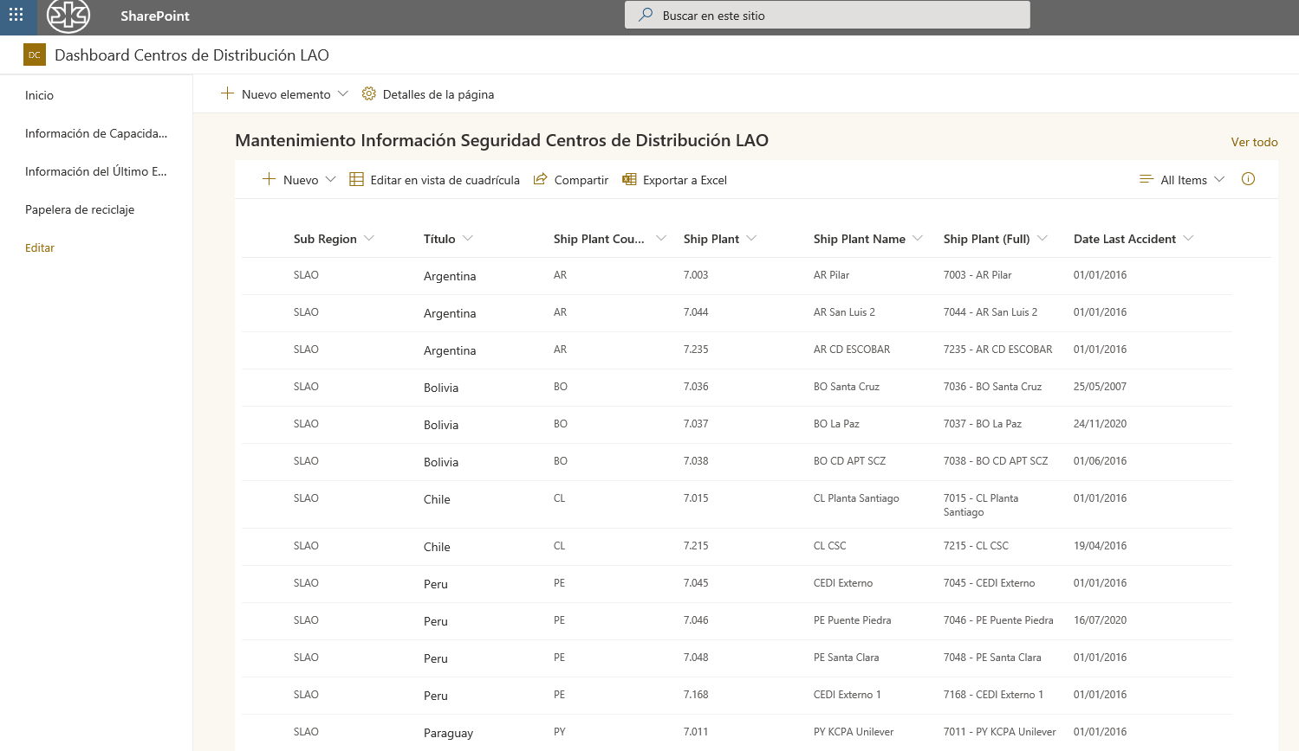
LAO Distribution Centers Days w/o Accidents
DC SharePoint
Days w/o Accident
https://kimberlyclark.sharepoint.com/Sites/H854/DCKPISDashboard/

Slide 9
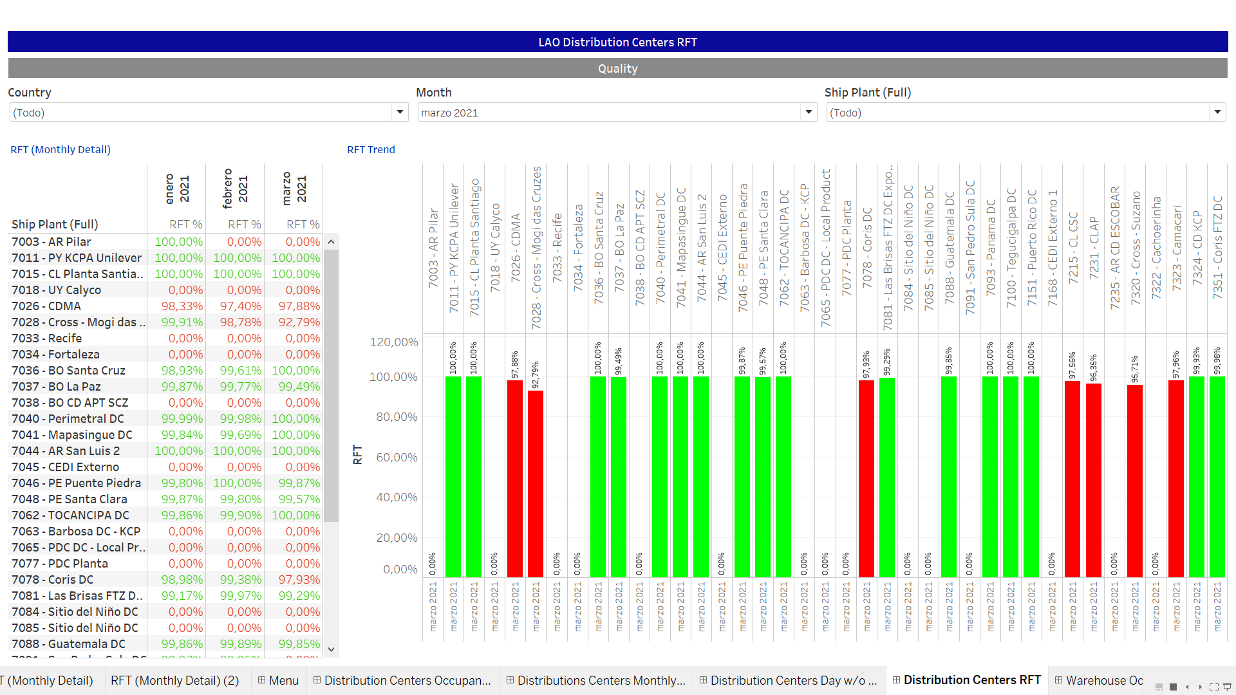
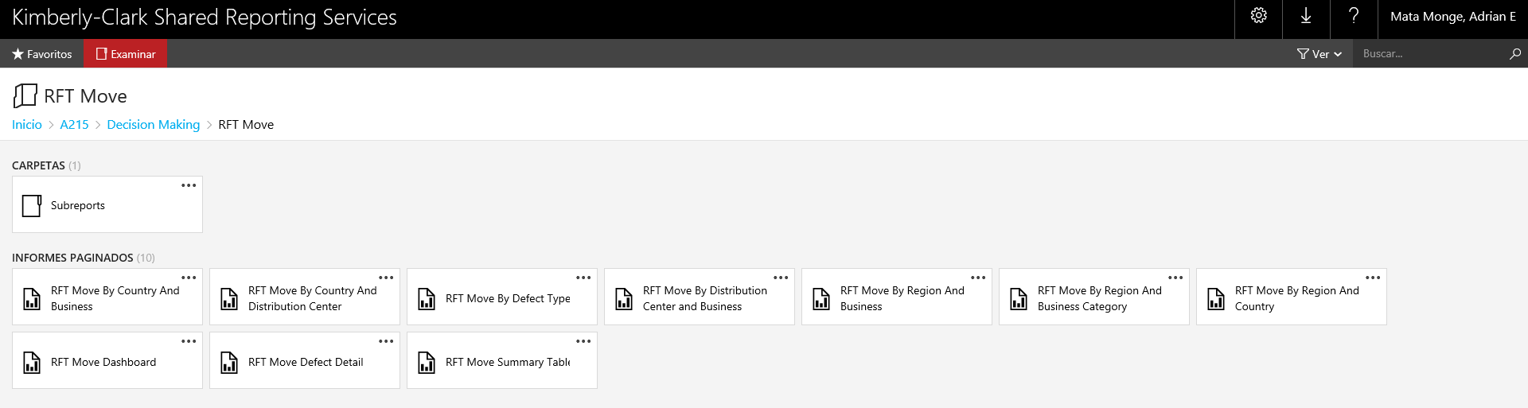
LAO Distribution Centers RFT
RFT Move Reporting
https://reports.kcc.com/reports/browse/A215/Decision%20Making/RFT%20Move

Slide 10
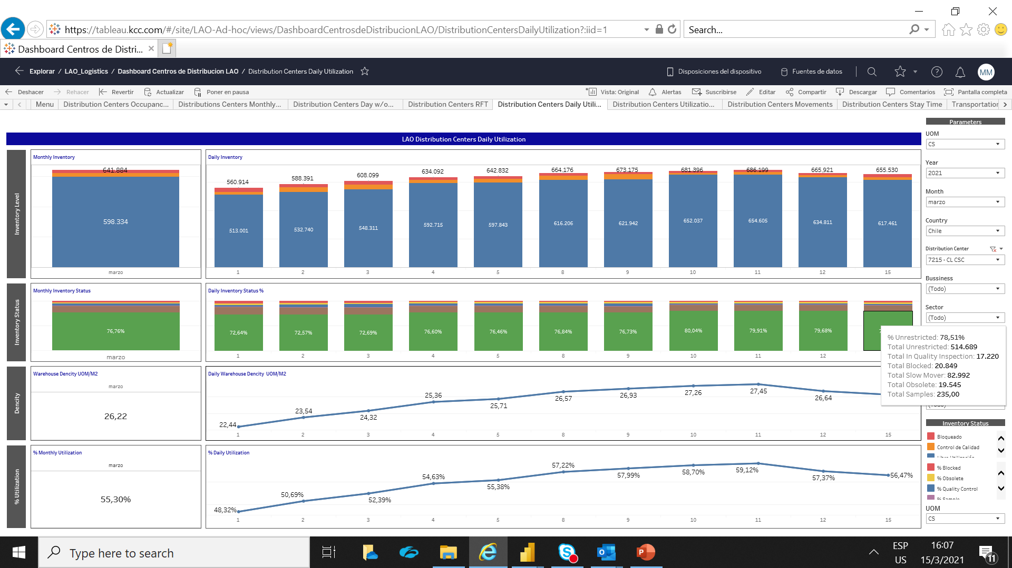
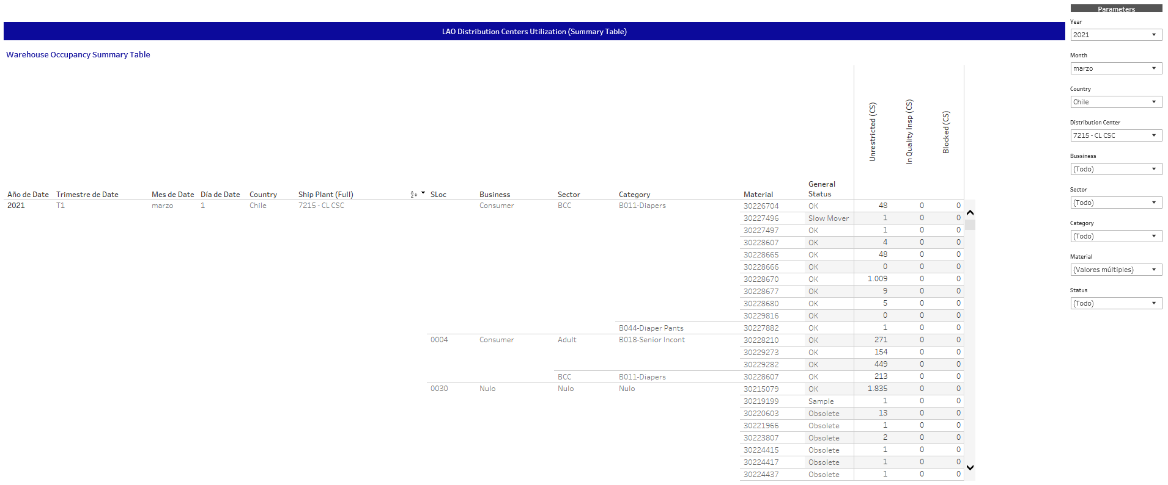
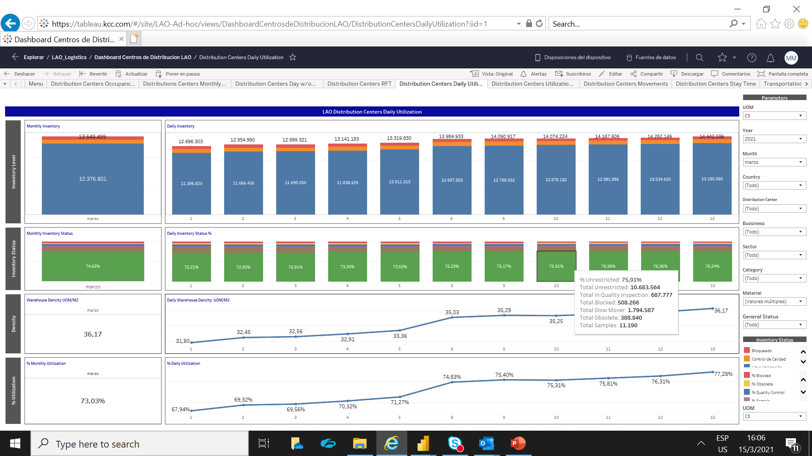
LAO Distribution Centers Daily Utilization
SAP/R3
MB52
Se puede
visualizar
en:
PAL
M3
CS

Slide 11
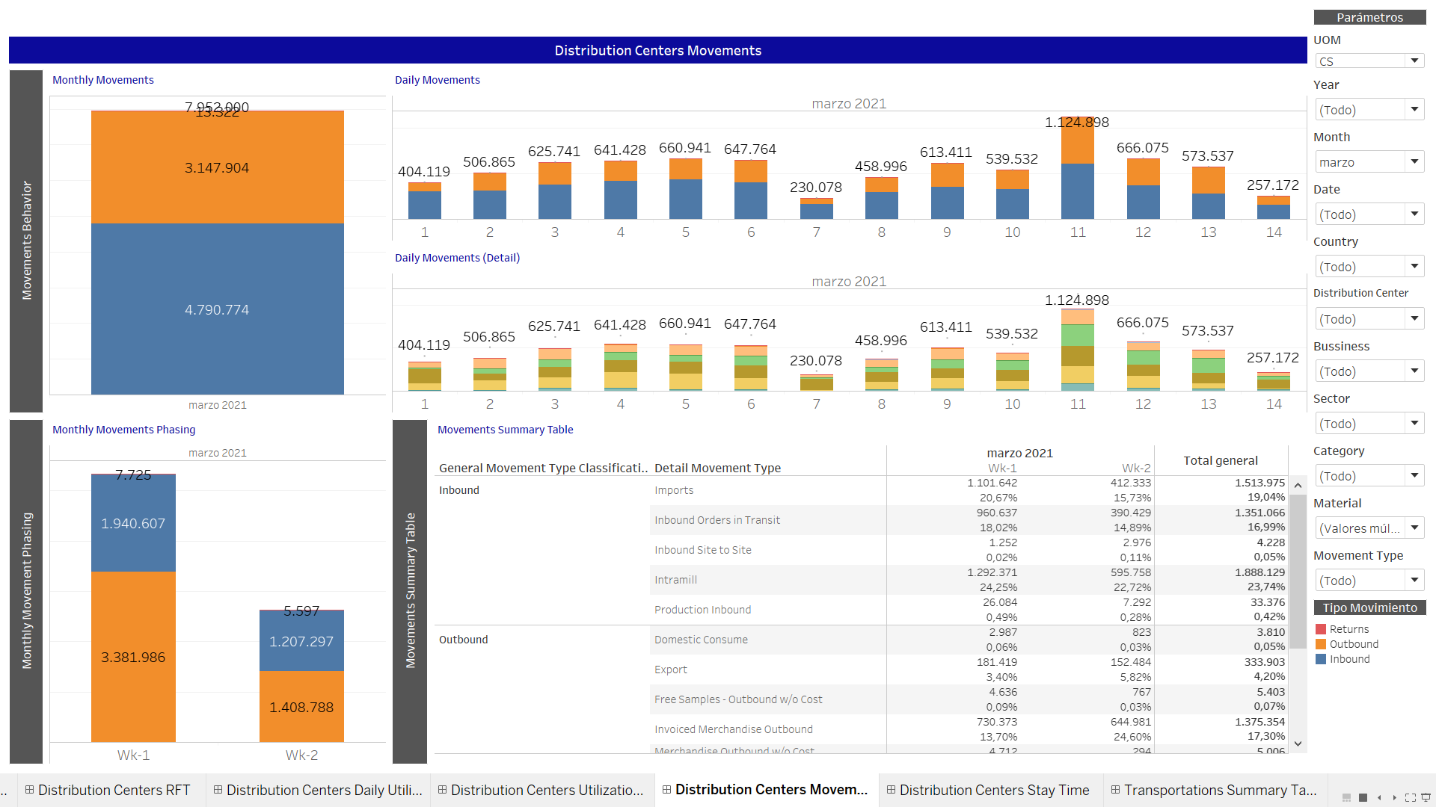
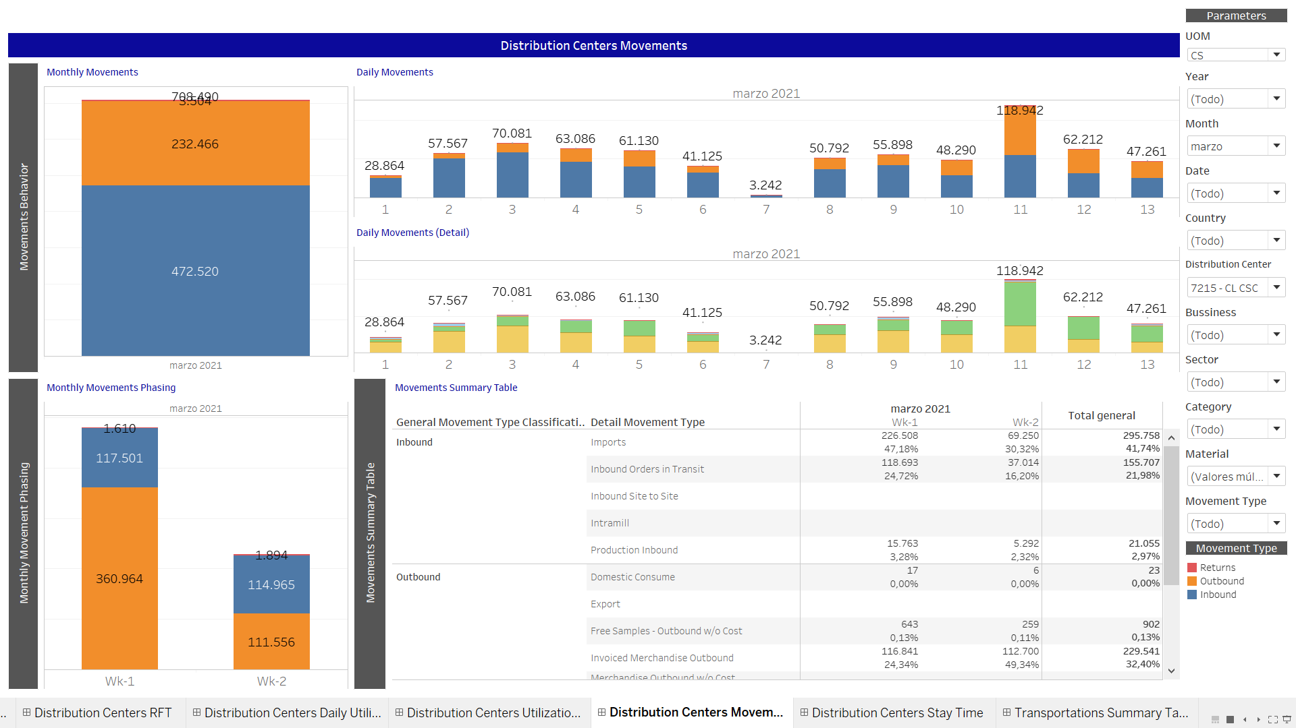
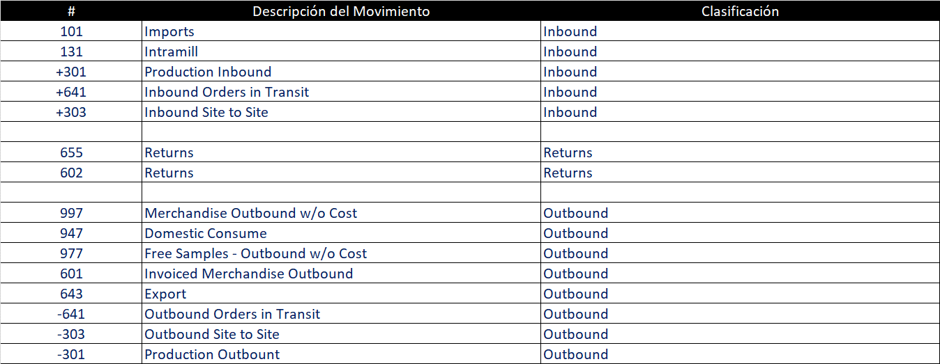
LAO Distribution Centers Daily Movements
SAP/R3
MB51
Se puede
visualizar
en:
PAL
M3
CS

Slide 12
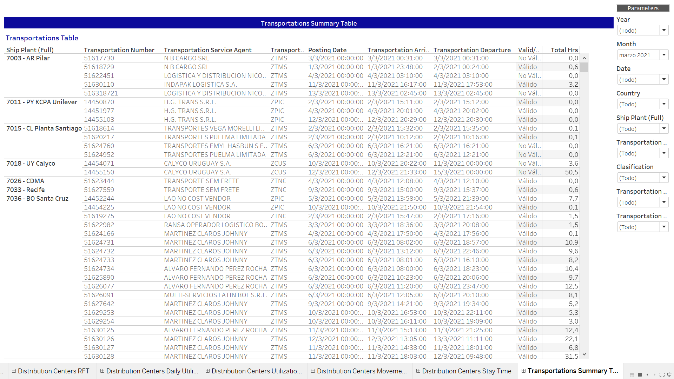
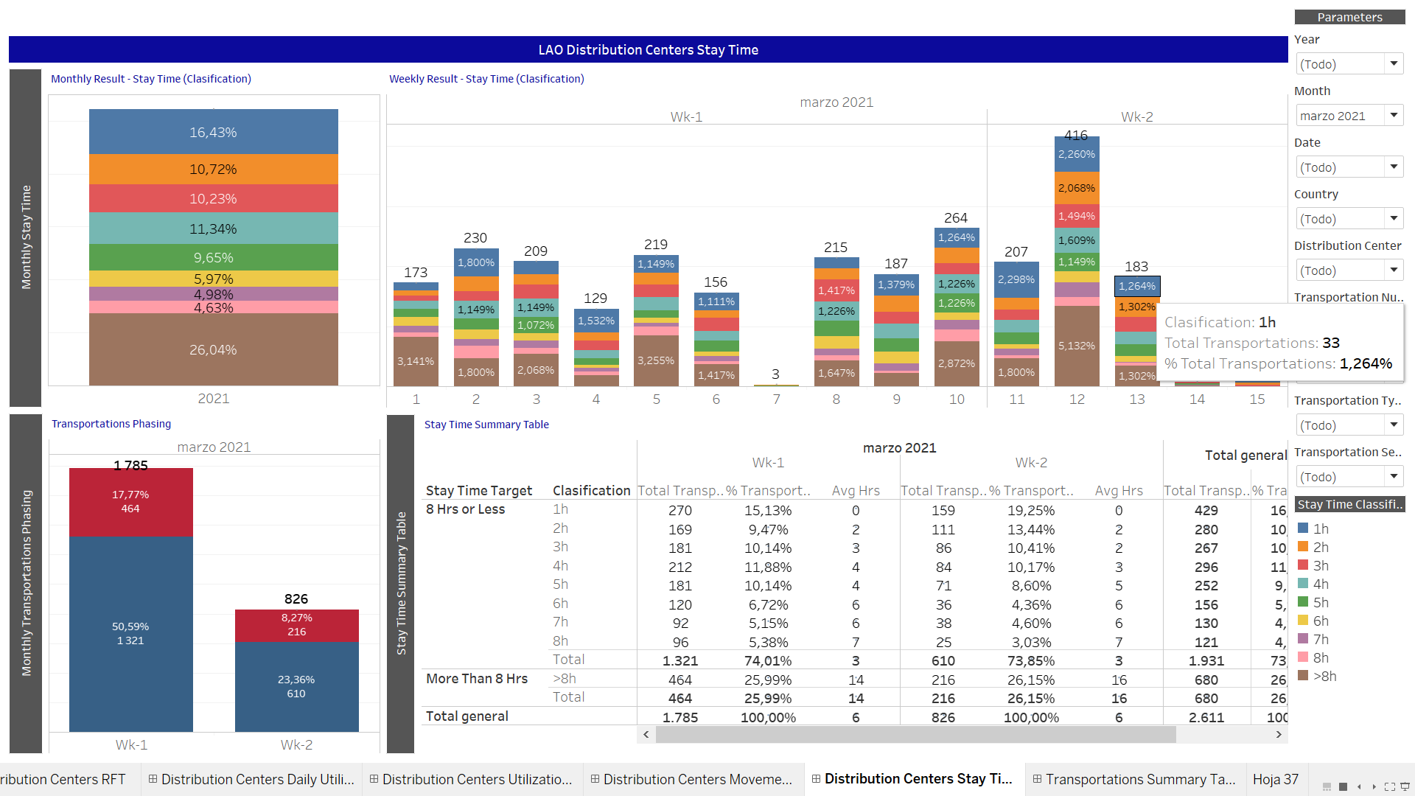
LAO Distribution Centers Stay Time
SAP/R3
VT11

Slide 13
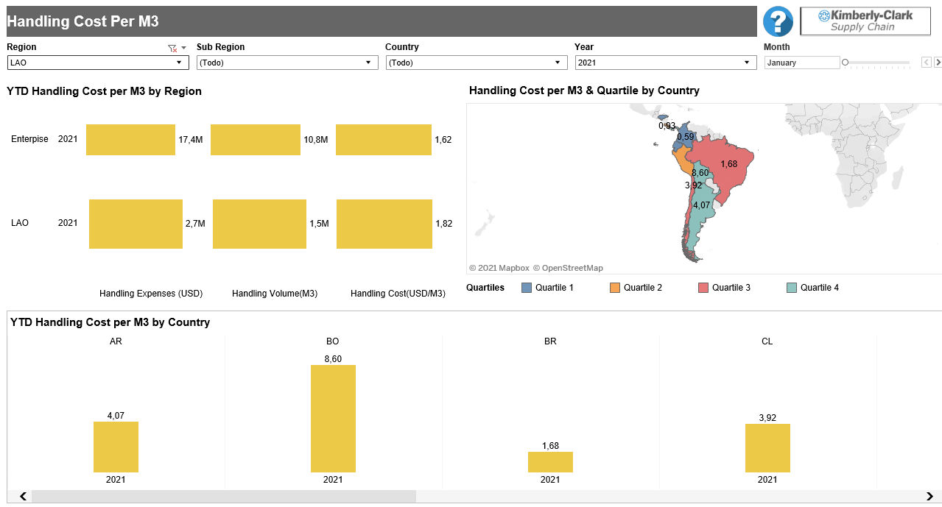
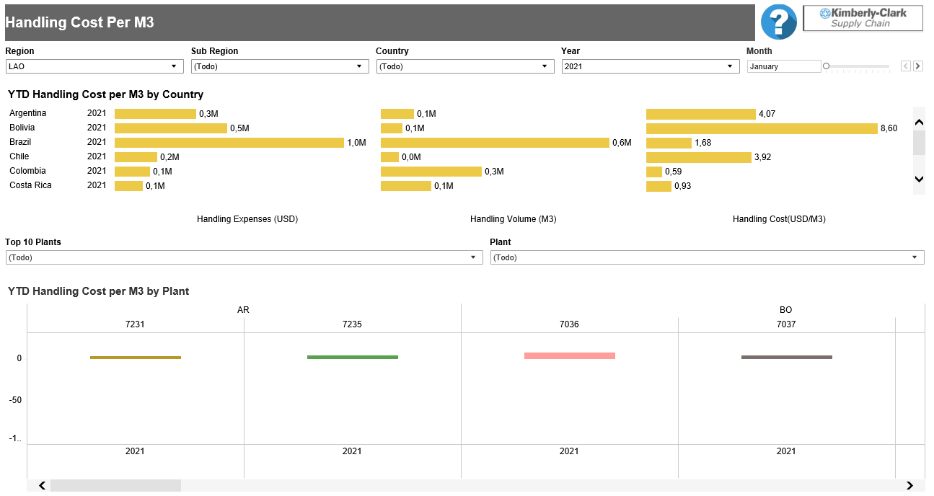
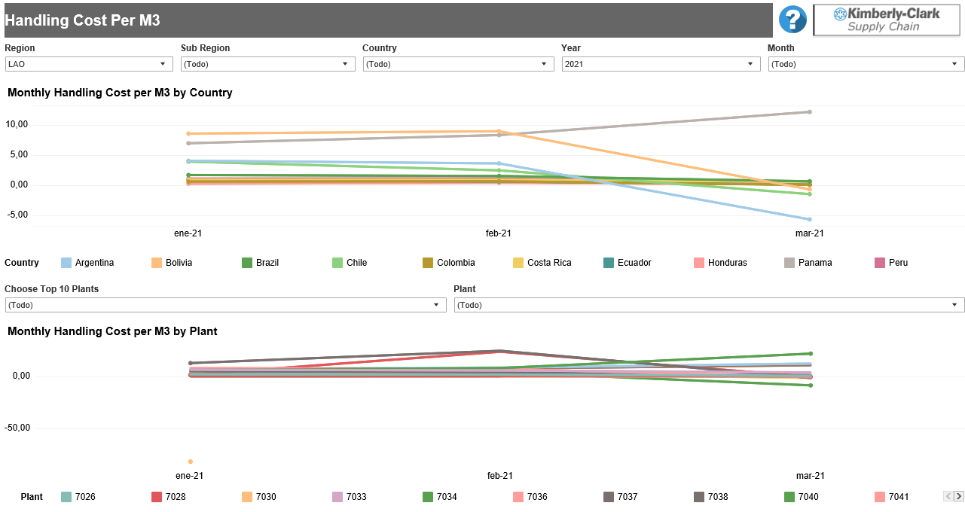
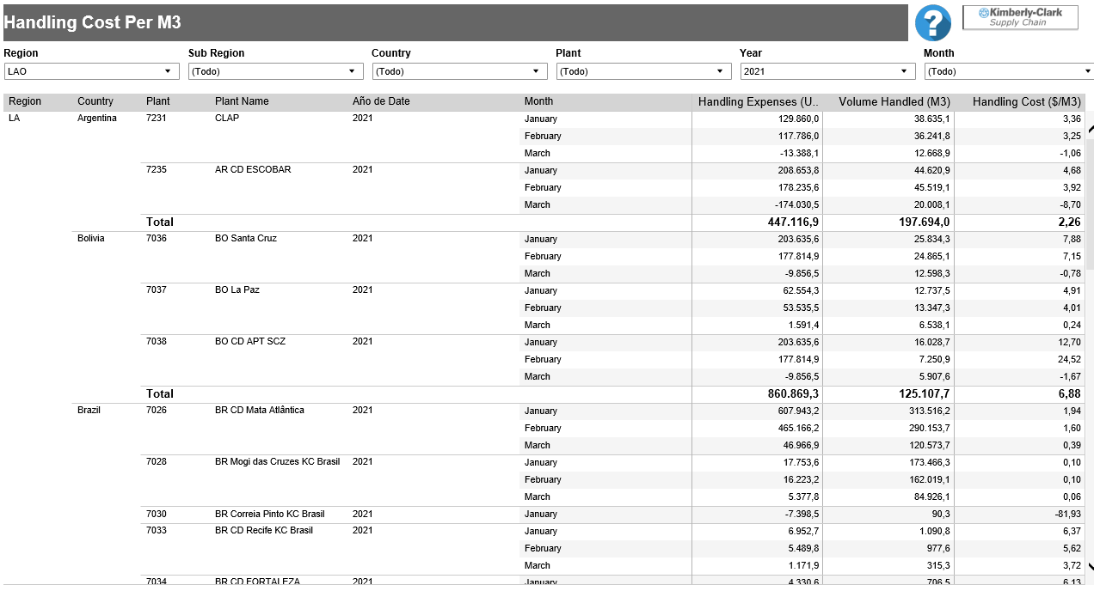
Handling Cost per M3

Slide 14
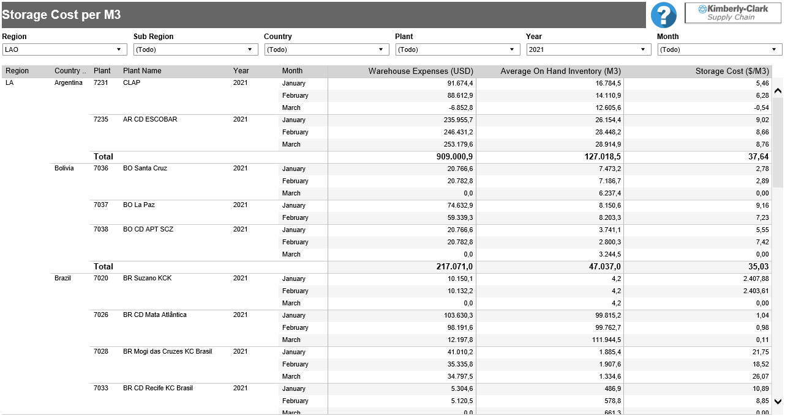
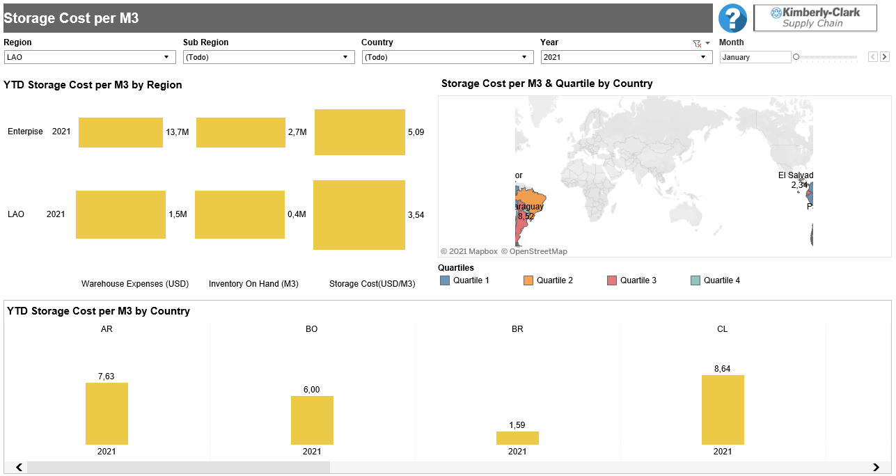
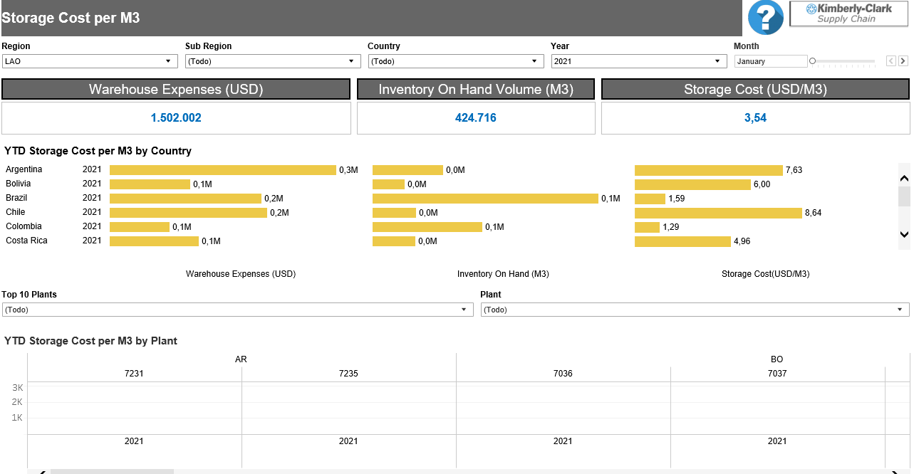
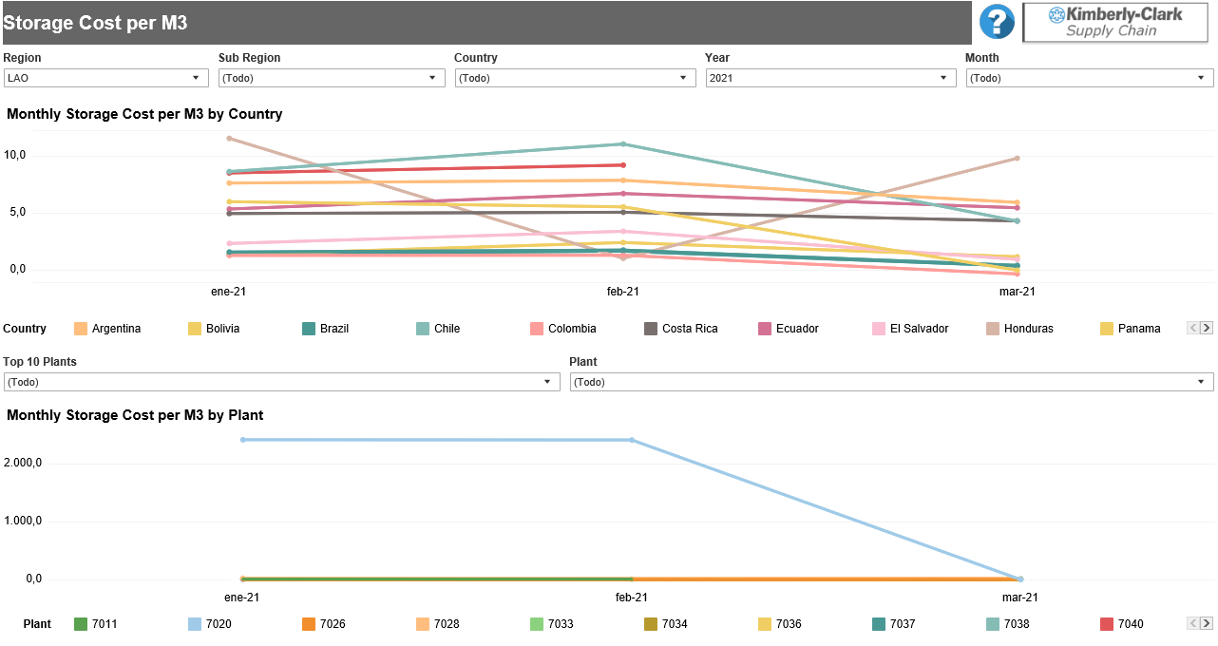
Storage Cost per M3

Slide 15
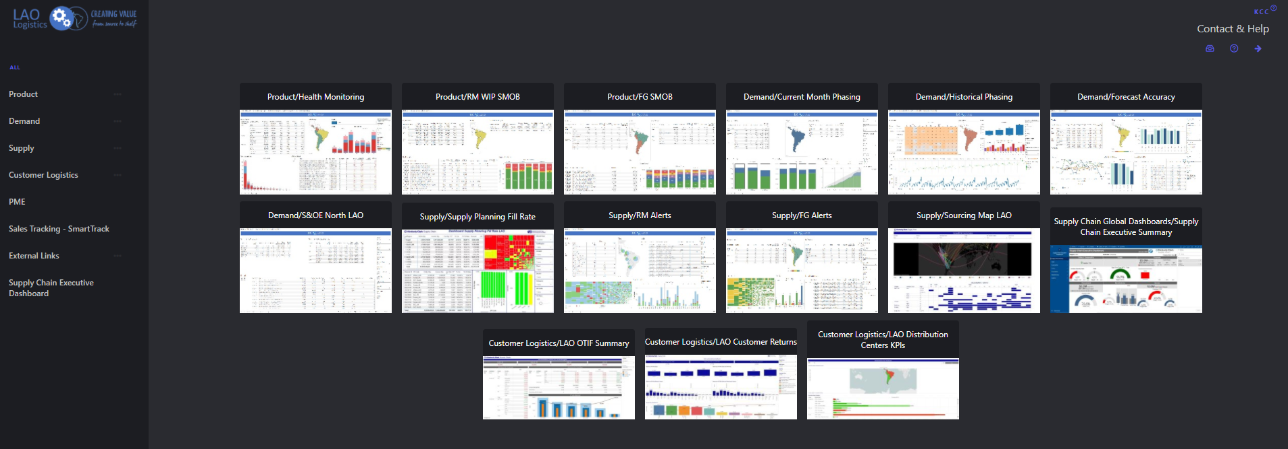
Link de Acceso
http://ustca957/hub/lao/

Slide 16
Kahoot!

